Slide 1
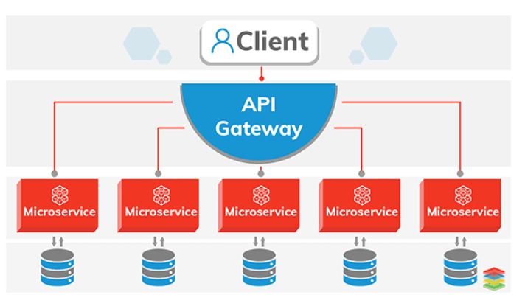
MICROSERVICES

Slide 2

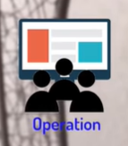
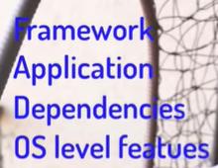

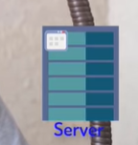

Slide 3
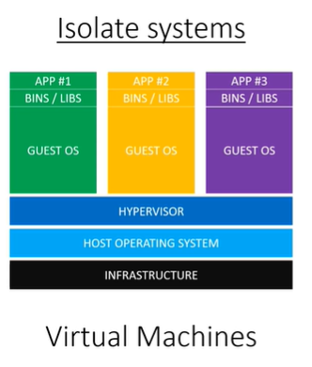
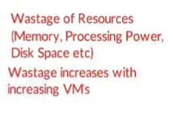

Slide 4
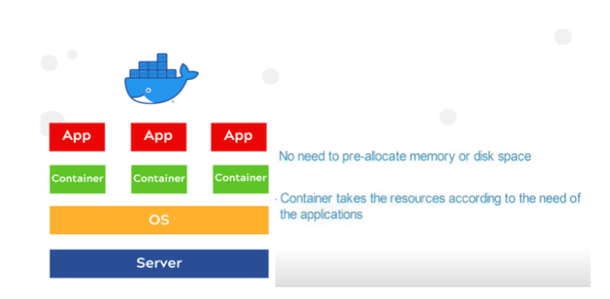
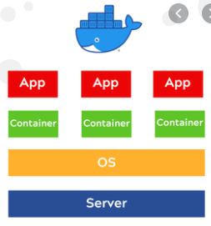
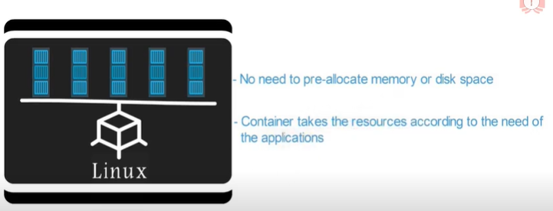
Docker Containers

Slide 5
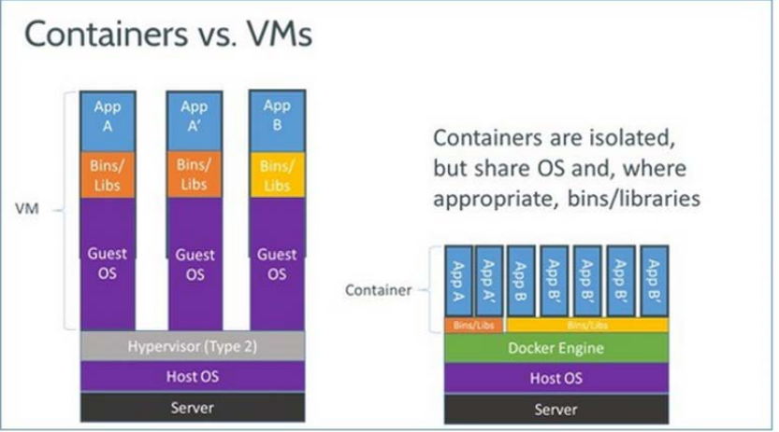

Slide 6
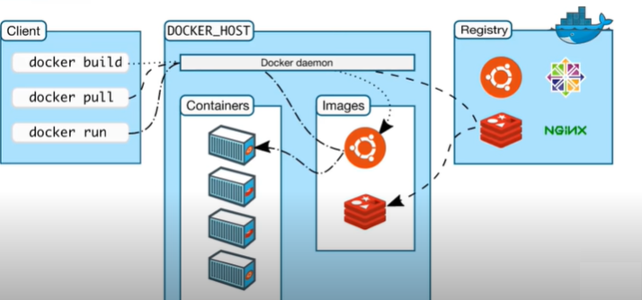
ARCHITECTURE

Slide 7
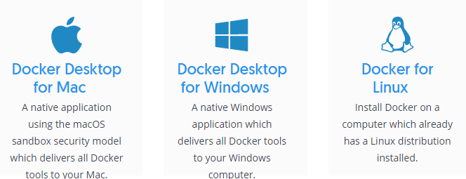
Installation:
https://docs.docker.com/

Slide 8
docker search – Searches the Docker Hub for images
docker run – Runs a command in a new container.
List All Running Containers
List All Containers Ever Created
List Only Container IDs – Quiet Output

Slide 9
docker exec – Runs a command in a run-time container
docker exec -it <container_id_or_name> /bin/bash
-i (interactive) flag to keep stdin open
-t to allocate a terminal
docker -d ubuntu_ 0f727e027da2 /tmp/execWorks
This will create a new file /tmp/execWorks inside the running container ubuntu_bash, in the background(-d)
docker stop – Stops one or more running containers

Slide 10
docker stop ----time=30 foo
When using docker stop the only thing you can control is the number of seconds that the Docker daemon will wait before sending the SIGKILL:
SIGKILL goes straight to the kernel which will terminate the process
docker kill ----signal=SIGINT foo
By default, the docker kill command doesn't give the container process an opportunity to exit gracefully -- it simply issues a SIGKILL to terminate the container. However, it does accept a --signal flag which will let you send something other than a SIGKILL to the container process
For example, if you wanted to send a SIGINT (the equivalent of a Ctrl-C on the terminal) to the container "foo" you could use the following
docker rm ----force foo
The final option for stopping a running container is to use the --force or -f flag in conjunction with the docker rm command. Typically, docker rm is used to remove an already stopped container, but the use of the -f flag will cause it to first issue a SIGKILL.

Slide 11
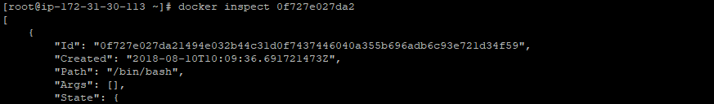
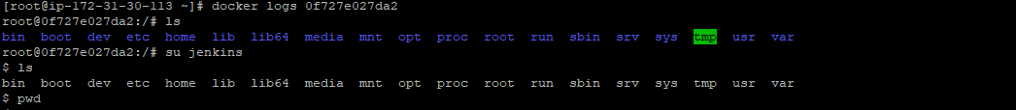
The final option for stopping a running container is to use the --force or -f flag in conjunction with the docker rm command. Typically, docker rm is used to remove an already stopped container, but the use of the -f flag will cause it to first issue a SIGKILL.
docker start – Starts one or more stopped containers
To show Container information like IP adress.
To show log of a Container.

Slide 12

docker run
Assign name and allocate pseudo-TTY (--name, -it)
Set working directory (-w)
The -w lets the command being executed inside directory given, here /path/to/dir/. If the path does not exist it is created inside the container.
Mount volume (-v)
docker run -v `pwd`:`pwd` -w `pwd` -i -t ubuntu pwd
The -v flag mounts the current working directory into the container. The -w lets the command being executed inside the current working directory, by changing into the directory to the value returned by pwd. So this combination executes the command using the container, but inside the current working directory.

Slide 13
docker run -v /host/path:/container/pat
Publish or expose port (-p, --expose)
sudo docker run -p 80:80 nginx
This binds port 80 of the container to TCP port 80 on 127.0.0.1 of the host machine.
docker run --expose 80 ubuntu bash
This exposes port 80 of the container without publishing the port to the host system’s interfaces.
Set environment variables (-e, --env, --env-file)
Use the -e, --env, and --env-file flags to set simple (non-array) environment variables in the container you’re running, or overwrite variables that are defined in the Dockerfile of the image you’re running.
docker run --env VAR1=value1 --env VAR2=value2 ubuntu env | grep VAR

Slide 14
$
Vi env.list
# This is a comment
VAR1=value1
VAR2=value2
docker run --env-file env.list ubuntu env | grep VAR
Create Volumes
create volumes using the docker volume create command
docker volume create --name my-vol
Attach to a container at run-time e
docker run -d -v my-vol:/data debian
This example will mount the my-vol volume at /data inside the containe

Slide 15
v flag — mounting a specific directory from the host into a container
docker run -v /home/adrian/data:/data debian ls /data
Will mount the directory /home/adrian/data on the host as /data inside the container.
Docker inspect volume_name (will give the volume loacation)
Deleting Volumes
docker rm -v command
docker volume rm $(docker volume ls -q)
Deleting Containers
docker rm <container ID>
docker rm $(docker ps -a -q)-→ Delete all the containers

Slide 16
Deleting Images
docker images → to check the images list
docker rmi image-name → Delete specific image
docker rmi $(docker images -q) → Delete all the images
Removing All Unused Objects
The docker system prune command will remove all stopped containers, all dangling images, and all unused networks
docker system prune
If you also want to remove all unused volumes, pass the --volumes flag
docker system prune --volumes
If you also want to check disk space utilized by docker
docker system df
If you also want to delete all unused containers and images
docker system prune -a

Slide 17
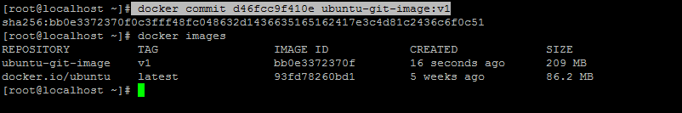
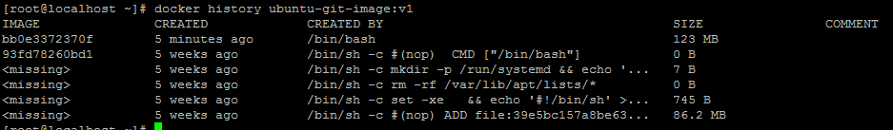
Commit container
docker run -it --name ubuntu-ctr ubuntu
root@d46fcc9f410e:/# apt-get install git (apt-get update then run install git)
Come out from the container with out exiting (Ctrl + p , Ctrl + q) and create new image for the container
docker commit d46fcc9f410e ubuntu-git-image:v1
History of the image
docker history ubuntu-git-image:v1

Slide 18
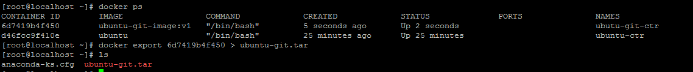
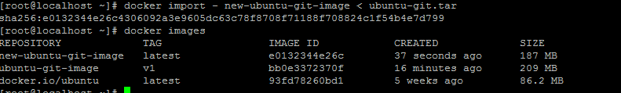
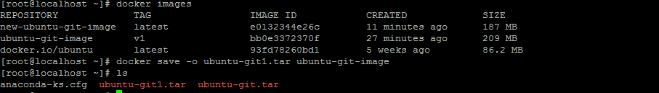
Export container as tar file
docker export 6d7419b4f450 > ubuntu-git.tar
Import as tar file as image:
docker import - new-ubuntu-git-image < ubuntu-git.tar
Export image as tar file
docker save -o ubuntu-git1.tar ubuntu-git-image

Slide 19
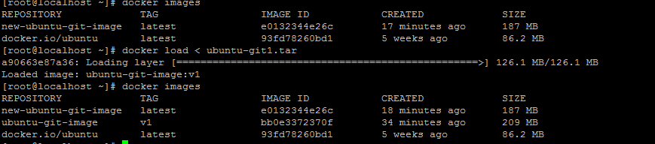
Load the image from tar file
docker load < ubuntu-git1.tar
Copy local machine content to docker and vice versa
Step 1 : Stop the container
Step 2 : docker cp source_path containerid:destination_path
docker cp containerid:source_path destination_path
Step 3 : strat the container and verify

Slide 20
Check the process Information
docker top containerid
Check the stats
docker stats containerid
Creating alias

Slide 21
Managing images in Docker HUB
Step 1 : Create account in docker hub (hub.docker.com)
Step 2 : Create repository
Step 2 : Login to the account
Step 3 : Select the image from docker images
Step 4 : tag the image
Step 5 : Push to docker hub
Login to docker account
Tag the image
docker tag ubuntu-git-image:v1 docker.io/raknas000/ubuntu-git-image:v1
Tag format : Registry name/repository/image:version
Rregistry name is docker.io for public and it is optional, if we did not pass docker will take
Repository is name of the repository where images are stored
Image with version (if version not mentioned then it will take it as latest)

Slide 22
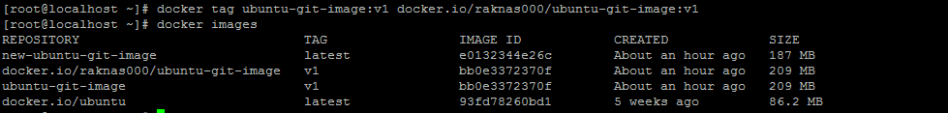
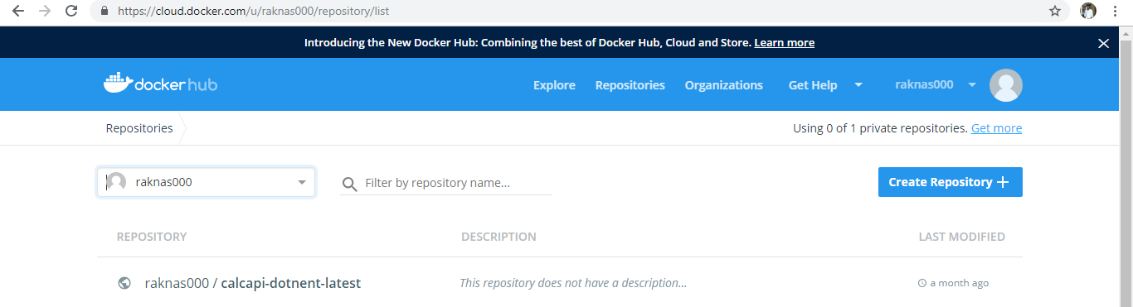
Push the image to Docker Hub
docker push docker.io/raknas000/ubuntu-git-image:v1

Slide 23
Wordpress Site setup
Create SQL Container
docker run --name wordpresssql -e MYSQL_ROOT_PASSWORD=password -d mysql:5.5
Create Wordpress Containter and link with SQL container
docker run --name mywp --link wordpresssql:mysql -P -d wordpress
mywp: is the container name
wordpresssql:mysql (mysql is alias name)
-P : expose all the ports which are used in the image
-d : run as deamon
wordpress : image name of wordpress

Slide 24
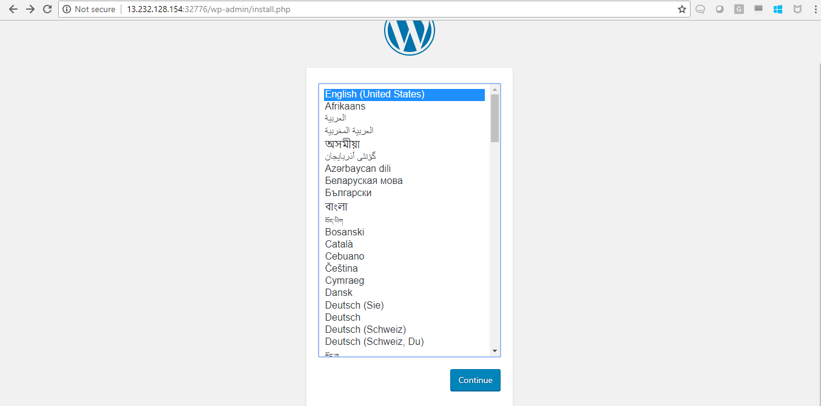
Launch the Word press site
Go to browser then give, hostname or ip:port number of container

Slide 25
Jenkins setup
[root@ip-172-31-21-153 docker]# docker run \
> -u root \
> --rm \
> -d \
> -p 8080:8080 \
> -p 50000:50000 \
> -v jenkins-data:/var/jenkins_home \
> -v /var/run/docker.sock:/var/run/docker.sock \
> jenkinsci/blueocean
Jenkinsci/blueocean is the image name for Jenkins
-v : mounting data
-p : port export

Slide 26
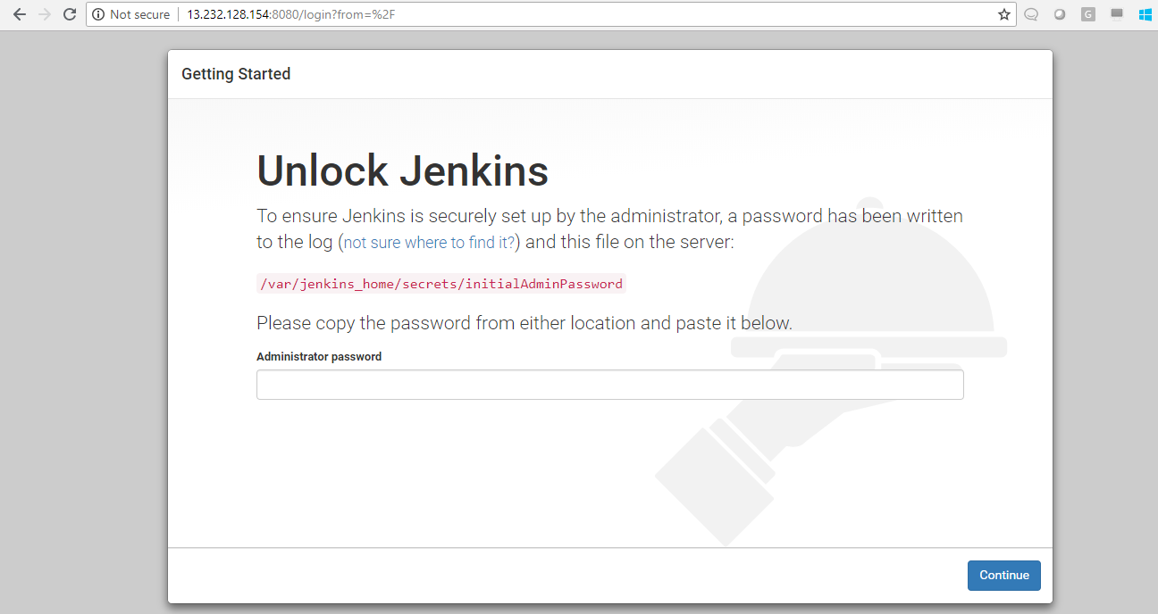
Launch Jenkins
Go to Browser they type hostname or ip:port number

Slide 27
Dockerfile
A Dockerfile is a script that contains collections of commands and instructions that will be automatically executed in sequence in the docker environment for building a new docker image.
FROM
FROM directive is probably the most crucial amongst all others for Dockerfiles. It defines the base image to use to start the build process. It can be any image, including the ones you have created previously. If a FROM image is not found on the host, Docker will try to find it (and download) from the Docker Hub or other container repository. It needs to be the first command declared inside a Dockerfile.
Example:
# Usage: FROM [image name]
FROM ubuntu
MAINTAINER
Optional, it contains the name of the maintainer of the image.
Example:
# Usage: MAINTAINER [name]
MAINTAINER authors_name
RUN
The RUN command is the central executing directive for Dockerfiles. It takes a command as its argument and runs it to form the image. Unlike CMD, it actually is used to build the image (forming another layer on top of the previous one which is committed).
.
CMD
Used for executing commands when we build a new container from the docker image.

Slide 28
Example:
# Usage: RUN [command]
RUN aptitude install -y riak
USER
The USER directive is used to set the UID (or username) which is to run the container based on the image being built.
Example:
# Usage: USER [UID]
USER 751
VOLUME
The VOLUME command is used to enable access from your container to a directory on the host machine (i.e. mounting it).
Example:
# Usage: VOLUME ["/dir_1", "/dir_2" ..]
VOLUME ["/my_files"]
ENV
The ENV command is used to set the environment variables (one or more). These variables consist of “key value” pairs which can be accessed within the container by scripts and applications alike. This functionality of Docker offers an enormous amount of flexibility for running programs.
Example:
# Usage: ENV key value
ENV SERVER_WORKS 4

Slide 29
ENTRYPOINT
ENTRYPOINT argument sets the concrete default application that is used every time a container is created using the image. For example, if you have installed a specific application inside an image and you will use this image to only run that application, you can state it with ENTRYPOINT and whenever a container is created from that image, your application will be the target.
If you couple ENTRYPOINT with CMD, you can remove "application" from CMD and just leave "arguments" which will be passed to the ENTRYPOINT.
Example:
ENTRYPOINT echo
OR
CMD "Hello docker!"
ENTRYPOINT echo
EXPOSE
The EXPOSE command is used to associate a specified port to enable networking between the running process inside the container and the outside world (i.e. the host).
Example:
Usage: EXPOSE [port]
EXPOSE 8080
ADD / COPY
The ADD command gets two arguments: a source and a destination. It basically copies the files from the source on the host into the container's own filesystem at the set destination. If, however, the source is a URL (e.g. http://github.com/user/file/), then the contents of the URL are downloaded and placed at the destination.
Usage: ADD [source directory or URL] [destination directory], EX : ADD /my_app_folder /my_app_folder

Slide 30
ENTRYPOINT
Define the default command that will be executed when the container is running.
WORKDIR
The WORKDIR directive is used to set where the command defined with CMD is to be executed.
Example:
# Usage: WORKDIR /path
WORKDIR ~/
CMD
The command CMD, similarly to RUN, can be used for executing a specific command. However, unlike RUN it is not executed during build, but when a container is instantiated using the image being built. Therefore, it should be considered as an initial, default command that gets executed (i.e. run) with the creation of containers based on the image.
To clarify: an example for CMD would be running an application upon creation of a container which is already installed using RUN (e.g. RUN apt-get install …) inside the image. This default application execution command that is set with CMD becomes the default and replaces any command which is passed during the creation.
Example:
Usage 1: CMD application "argument", "argument", ..
CMD "echo" "Hello docker!"

Slide 31
Apache Server
Dockerfile
FROM httpd:2.4
COPY ./public-html/ /usr/local/apache2/htdocs/
Index.html file in public-html directory
<html>
<body>
Hi There - Static page served by Apache Server
</body>
</html>
Build image
docker build -t my-apache2 .
Create Container
docker run -p 80:80 --name my-apache2-1 my-apache2
Open browser of the host at http://localhost:80, you will see the website up and running
Login to container and verify
docker exec -ti <container id> /bin/bash

Slide 32
Java Example
mkdir java-app
create Hello.java file with below content
class Hello{
public static void main(String[] args){
System.out.println("This is java app \n by using Docker");
}
}
create Dockerfile with below content
FROM java:8
COPY . /var/www/java
WORKDIR /var/www/java
RUN javac Hello.java
CMD ["java", "Hello"]
Build Image
docker build -t java-app .
Create Container
docker run java-app

Slide 33
Save the Docker Image file so that it can be copied and used in other machines
docker save –o /root/java-app.tar java-appl
Run the following command to load Docker image in another machine
docker load –i /root/java-app.tar
Run the Docker image
docker run java-app
Ubuntu Example
Dockerfile
FROM ubuntu
docker build -t ubuntu-in-doker .
docker run -td ubuntu (to run) (if failes check images)
docker ps -a(to check container id)
docker exec -it <container id> bash (to enter into ubuntu)
ctrl+d (to come out)

Slide 34
Apache Setup
Dockerfile
FROM centos
MAINTAINER sankar <user@domain.tld>
RUN yum -y install httpd
ADD index.html /var/www/html/index.html
CMD ["/usr/sbin/httpd","-D","FOREGROUND"]
EXPOSE 80
Index.html
[root@ip-172-31-30-113 apache]# cat index.html
<header>
<h1>Docker Add is neat</h1>
</header>
Build image
docker build -t webwithdb .
Create Container
docker run -d -p 81:80 webwithdb

Slide 35
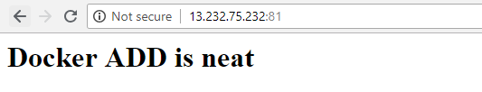
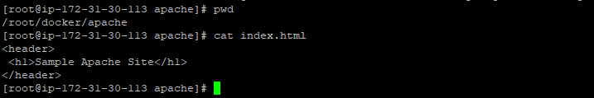
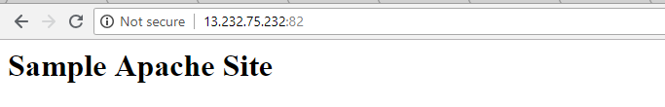
Verify in the browser
Attach Volume
docker run -v /path/to/host/directory:/path/inside/the/container image
docker run -d -p 82:80 -v /root/docker/apache:/var/www/html webwithdb
Open browser and check with port 82

Slide 36

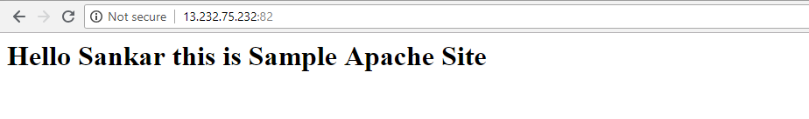
Modify Index.html on local machine
Refresh the page automatically content will be updated

Slide 37
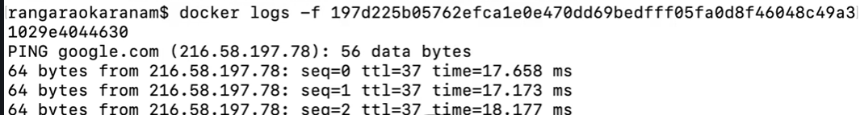
Difference between Entrypoint and CMD
Entrypoint is static which can’t be modified while launching the container
CMD is not static it can be overwritten with command line arguments while launching the container
Note : While launching the container if we want to overwrite entrypoint then –entrypoint option has to be used
Example
Check the logs, we can observer ping is working:
Codebase to check the Dockerfiles : https://github.com/in28minutes/devops-master-class

Slide 38
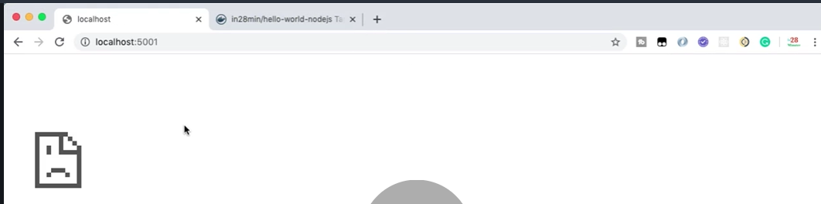
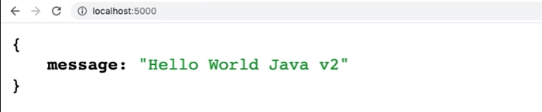
Try to Access the Application, it will not be reachable since command line argument overwritten CMD
Same case with Entrypoint, it will not allow to overwrite

Slide 39
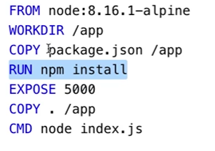
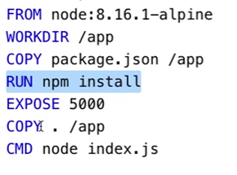
Improving Layer Caching:
In this case dependencies are installed every time even for the code change but no updates for dependencies.
In this case dependencies are not installed every time for every code change since dependencies are handling separately.

Slide 40
Docker Compose
Docker Compose is used to run multiple containers as a single service. For example, suppose you had an application which required NGNIX and MySQL, you could create one file which would start both the containers as a service without the need to start each one separately.
Step 1 — Installing Docker
yum -y install docker docker-registry
usermod -aG docker $(whoami)
systemctl enable docker
systemctl start docker
Step 2 — Installing Docker Compose
sudo yum install epel-release
yum install gcc python-devel krb5-devel krb5-workstation
yum install python-pip -y
sudo pip install docker-compose
sudo yum upgrade python*
docker-compose -v

Slide 41
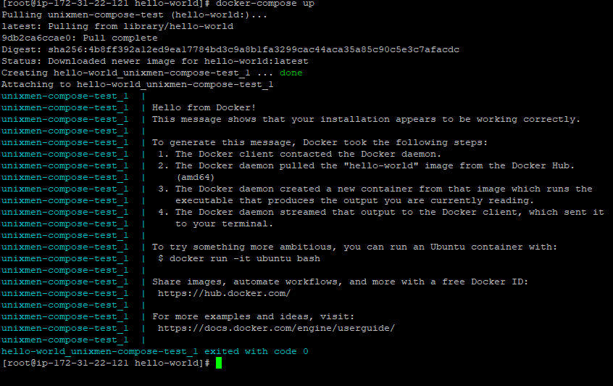
Testing Docker Compose
mkdir hello-world
cd hello-world
vi docker-compose.yml
unixmen-compose-test:
image: hello-world
sudo docker-compose up
Troubleshoot:
If docker-compose is not running
Check the owner info of the file
sudo ls -la /var/run/docker.sock
If it is with root then change it to
sudo chown ec2-user /var/run/docker.sock

Slide 42
Run in the background.
docker-compose up -d
To show group of Docker containers (both stopped and currently running)
docker-compose ps
To stop all running Docker containers for an application group
docker-compose stop
Note : above command in the same directory as the docker-compose.yml
To check syntax errors
docker-compose config
To remove old containers
docker-compose rm
Compose and WordPress
mkdir word-press
cd word-press
Vi docker-compose.yml

Slide 43
version: '3.3'
services:
db:
image: mysql:5.7
volumes:
- db_data:/var/lib/mysql
restart: always
environment:
MYSQL_ROOT_PASSWORD: somewordpress
MYSQL_DATABASE: wordpress
MYSQL_USER: wordpress
MYSQL_PASSWORD: wordpress
wordpress:
depends_on:
- db
image: wordpress:latest
ports:
- "8000:80"
restart: always
environment:
WORDPRESS_DB_HOST: db:3306
WORDPRESS_DB_USER: wordpress
WORDPRESS_DB_PASSWORD: wordpress
volumes:
db_data:

Slide 44
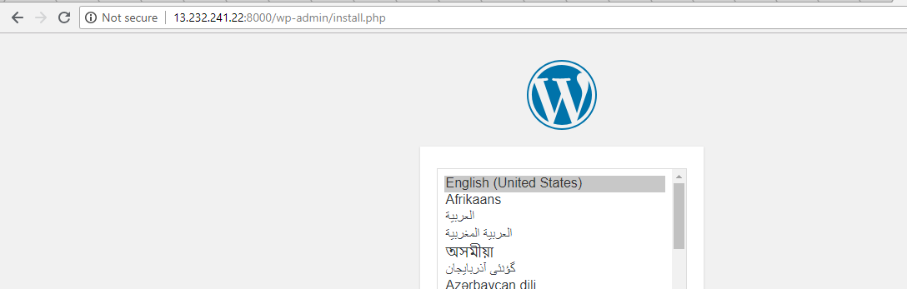
Verify in the browser
docker exec -it workdpress_db_
mysql -u wordpress -p

Slide 45
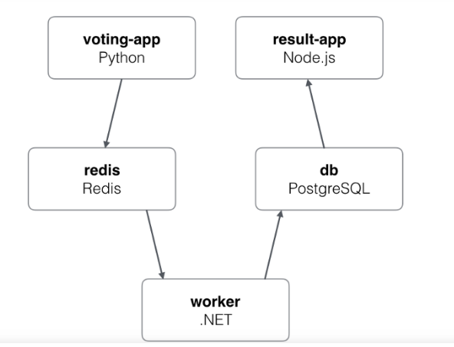
The Voting App
Introducing the most favourite demonstration app for the Docker community “The Voting App”, as if it needs an introduction at all. This is a simple application based on micro-services architecture, consisting of 5 simple services.

Slide 46
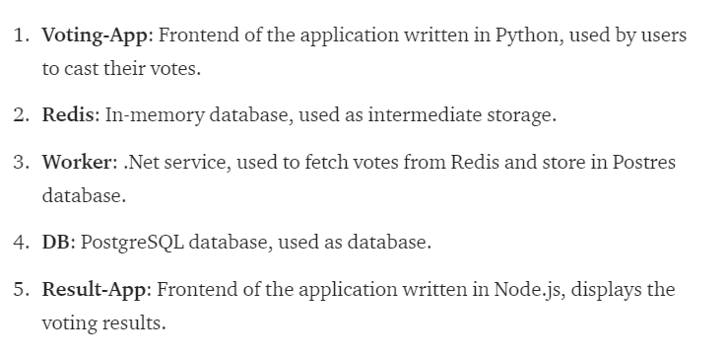

Slide 47
Compose file path:
https://gist.github.com/faizanbashir/36b81228ea941dcc49575dc69b8369d9#file-docker-compose-yml
Code path
https://github.com/dockersamples/example-voting-app.git
Docker Compose File Reference:
https://docs.docker.com/compose/compose-file/

Slide 48
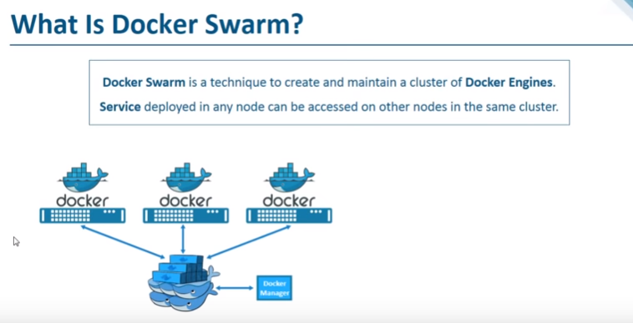
Docker Swarm

Slide 49
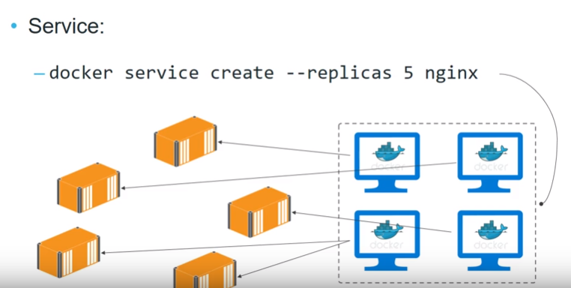

Slide 50
Docker Swarm
Docker Swarm is a clustering and scheduling tool for Docker containers. With Swarm, IT administrators and developers can establish and manage a cluster of Docker nodes as a single virtual system.
Swarm setup
Prerequisites
2 or more - Ubuntu 16.04 Server (if aws mahines change the security group to allow traffic)
manager
worker01
worker02
Root privileges
Edit vim /etc/hosts on both machines add below lines change the ip address
root@ip-172-31-24-107:~# cat /etc/hosts
18.222.159.153 manager
13.58.74.39 worker01
18.220.166.15 worker02
ping all the nodes using 'hostname' instead using IP address
ping -c 3 manager ping -c 3 worker01
Ping –c3 worker02

Slide 51
Install Docker-ce on all the machines
sudo apt install apt-transport-https software-properties-common ca-certificates -y
Add the Docker key and the Docker-ce repository to our servers
curl -fsSL https://download.docker.com/linux/debian/gpg | sudo apt-key add - sudo echo "deb [arch=amd64] https://download.docker.com/linux/ubuntu xenial stable" > /etc/apt/sources.list.d/docker-ce.list
Update the repository and install Docker-ce packages
sudo apt update sudo apt install docker-ce -y
start the docker service and enable it to launch every time at system boot
systemctl start docker systemctl enable docker
we will configure docker to run as a normal user or non-root user
Create a new user named ‘sankar' and add it to the 'docker' group.
useradd -m -s /bin/bash sankar sudo usermod -aG docker sankar

Slide 52
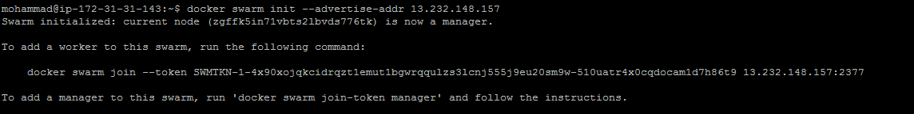
Now login to the ‘sankar' user and run the docker hello-world command as below
su - sankar docker run hello-world
Create the Swarm Cluster
docker swarm init --advertise-addr 13.232.148.157
'join-token' has been generated by the 'manager' node.
we need to add the 'worker01' node to the cluster 'manager'. And to do that, we need a 'join-token' from the cluster 'manager' node
Go to worker01 node and run the below command

Slide 53
Check it by running the following command on the 'manager' node.
docker node ls
Now you see the 'worker01‘ and ‘worker02’ nodes are joined to the swarm cluster
Deploying First Service to the Cluster
we will create and deploy our first service to the swarm cluster. We want to create new service Nginx web server that will run on default http port 80, and then expose it to the port 8080 on the host server, and then try to replicate the nginx service inside the swarm cluster
docker service create --name my-web --publish 8080:80 nginx:1.13-alpine

Slide 54
check using docker service
docker service ls
The Nginx service has been created and deployed to the swarm cluster as a service named 'my-web', it's based on the Nginx Alpine Linux, expose the HTTP port of the container service to the port '8080' on the host, and it has only 1 replicas
To check on which node service is running
Check on the node whether it is running or not, go to the node and run the command

Slide 55
Change the load from manager to worker node
docker node update --availability drain ip-172-31-44-230 (stopping the node where service is running)
After stopping of the manager , service should be moved to other node of the cluster
Scale up the service
docker service scale my-web=10
Check the service info

Slide 56
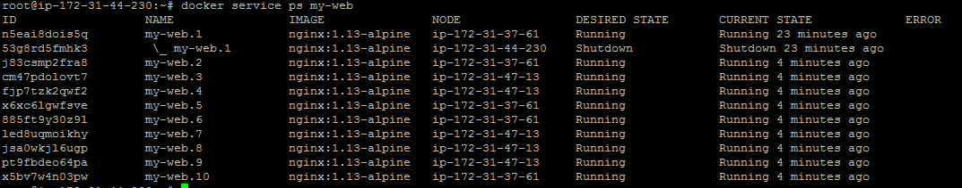
Check the containers info
So 10 containers are distributed among the nodes
Bring back the manager online
docker node update --availability active ip-172-31-44-230

Slide 57
Shutdown one of the node, so we can observer load is distributed among manger and other node
docker node update --availability active ip-172-31-44-231 (worker01)
Check the container list on the manager node, go to manager node and run the below command
Check the container list on the node2, go to worker02 node and run the below command

Slide 58
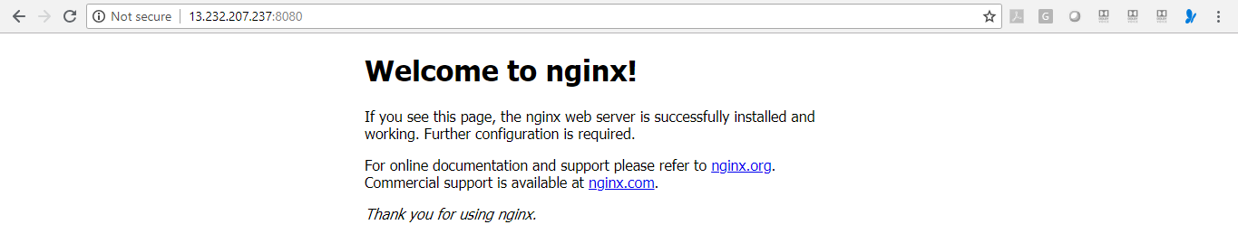
Open your web browser and type the worker node IP address with port 8080

Slide 59
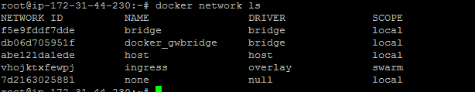
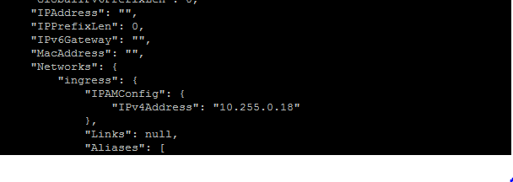
Network information
Ingress network manages all the nodes are under cluster so that one can communicate others
Check any container information which network it is using
Docker inspect containerid

Slide 60


If we want to maintain group of containers in one network and other group in other network ingress will not work so we need to create our own network
Remove the service my-web
Create new network
docker network create -d overlay mynetwork
Create service and attach it to the created network
docker service create --name my-web --network mynetwork -p 8080:80 nginx

Slide 61
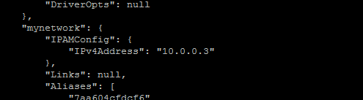
Check the service on which node it is running
Check the container network info
docker inspect 7aa604cfdcf6

Slide 62

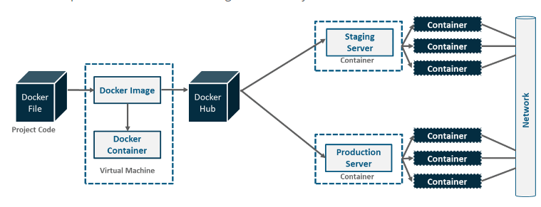

Slide 63
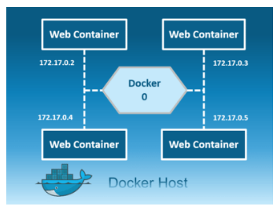
Network Drivers
Bridge: The bridge network is a private default internal network created by docker on the host. So, all containers get an internal IP address and these containers can access each other, using this internal IP. It can not communicate with name of the containers

Slide 64
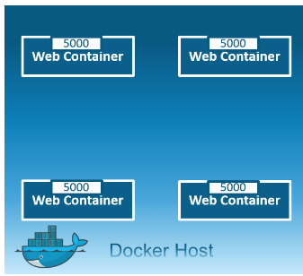
Host: This driver removes the network isolation between the docker host and the docker containers to use the host’s networking directly. So with this, you will not be able to run multiple web containers on the same host, on the same port as the port is now common to all containers in the host network.

Slide 65
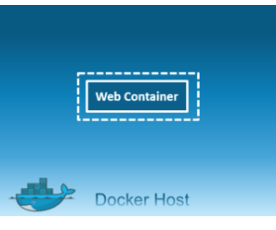
None: In this kind of network, containers are not attached to any network and do not have any access to the external network or other containers. So, this network is used when you want to completely disable the networking stack on a container and, only create a loopback device

Slide 66
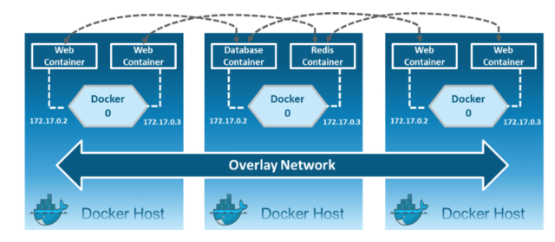
Overlay: Creates an internal private network that spans across all the nodes participating in the swarm cluster. So, Overlay networks facilitate communication between a swarm service and a standalone container, or between two standalone containers on different Docker Daemons.

Slide 67

Macvlan: Allows you to assign a MAC address to a container, making it appear as a physical device on your network. Then, the Docker daemon routes traffic to containers by their MAC addresses

Slide 68


To check network drivers : docker network ls
To check driver details : docker inspect bridge

Slide 69


Default network driver is: Bridge
[root@ip-172-31-42-6 ~]# docker ps
CONTAINER ID IMAGE COMMAND CREATED STATUS PORTS NAMES
19813fa5da9e ubuntu "/bin/bash" 29 minutes ago Up 29 minutes ubunut-ctr2
ee366634a931 ubuntu "/bin/bash" 29 minutes ago Up 29 minutes ubunut-ctr1
To check container details : docker inspect ubunut-ctr1
Network driver details of the container:

Slide 70


docker network inspect bridge
Connect to one of the container :docker network inspect bridge

Slide 71

Ping the other container with IP Address:
By default ping is not avialable in ubuntu container, install ping
apt-get update
apt-get install iputils-ping
Ping the other container with name:
Come out from container :
Exit
Or
Ctrl+p and Ctrol+q

Slide 72

Create Network :
docker network create --driver=bridge custom-network
Check the network
Create container with custom network
docker run -dit --name=ubuntu-ctr3 --network=custom-network ubuntu
docker run -dit --name=ubuntu-ctr4 --network=custom-network ubuntu

Slide 73


docker inspect custom-network
Login to one container and ping other one with IP Address and name

Slide 74

Change the Network driver for existing containers
Step 1 : Disconnect from existing driver : docker network disconnect bridge 26febb6f4867
Step 2 : Connect to new driver : docker network connect custom-network 26febb6f4867
Note: It is possible only for bridge networks not for others (two different bridge networks)
Remove one or more networks
docker network rm NETWORK

Slide 75
Building Docker Image for Tomcat with Specified War file from Nexus
Dockerfile
FROM tomcat
MAINTAINER sankar
ARG CONT_IMG_VER
WORKDIR /usr/local/tomcat
COPY tomcat-users.xml /usr/local/tomcat/conf/tomcat-users.xml
EXPOSE 8080
ADD http://52.14.64.164:8081/nexus/content/repositories/releases/com/geekcap/vmturbo/hello-world-servlet-example/${CONT_IMG_VER}/hello-world-servlet-example-${CONT_IMG_VER}.war /usr/local/tomcat/webapps
Building Image
docker build -t new-tomcat-image2 --build-arg CONT_IMG_VER=1.0 .
tomcat-user.xml
<role rolename="manager-gui"/>
<role rolename="manager-script"/>
<role rolename="manager-jmx"/>
<role rolename="manager-status"/>
<user username="admin" password="admin" roles="manager-gui,manager-script,manager-jmx,manager-status"/>

